Slide 1

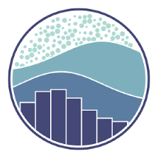
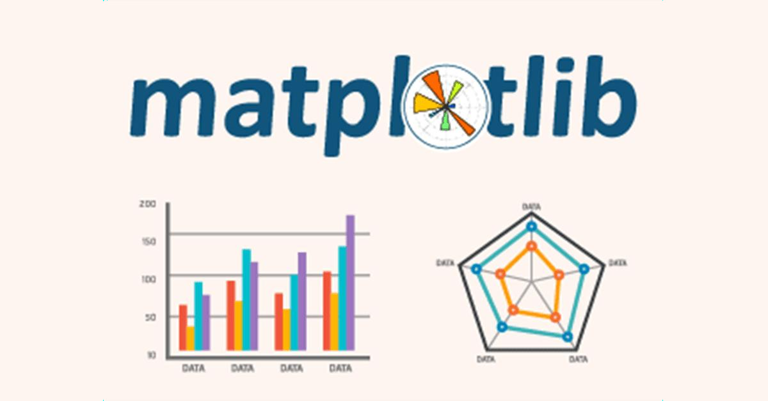
Data Visualization with Python Matplotlib and Seaborn
Chandan Saroj
"In God we trust, all others must bring data." – W. Edwards Deming

Slide 2
Introduction to Matplotlib
What is Matplotlib?
Matplotlib is a Python library used for data visualization.
It allows the creation of static, animated, and interactive plots.
Highly customizable and widely used in data science and machine learning.

Slide 3
Key Features
Variety of plots: Line, Bar, Histogram, Scatter, etc.
High level of customization (titles, labels, legends, etc.).
Support for multiple output formats (PNG, PDF, etc.).
Integrates with libraries like NumPy and Pandas.

Slide 4
Installing Matplotlib
pip install matplotlib
Basic Workflow
Import the library: import matplotlib.pyplot as plt
Prepare the data: Arrays or lists or load data from CSV
Create a plot using functions like plt.plot().
Customize the plot: Titles, labels, legends.
Display or save the plot using plt.show() or plt.savefig().

Slide 5
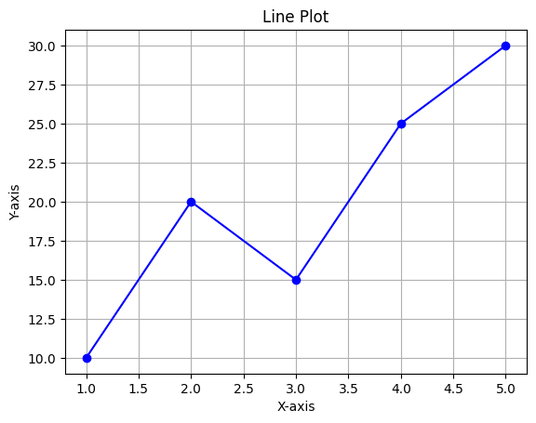
Common Plot Types
Line Plot
Visualizes trends over time or sequences
import matplotlib.pyplot as plt
x = [1, 2, 3, 4, 5]
y = [10, 20, 15, 25, 30]
plt.plot(x, y, marker=‘o', linestyle=‘-', color='blue') plt.title("Line Plot")
plt.xlabel("X-axis") plt.ylabel("Y-axis")
plt.grid()
plt.show()

Slide 6
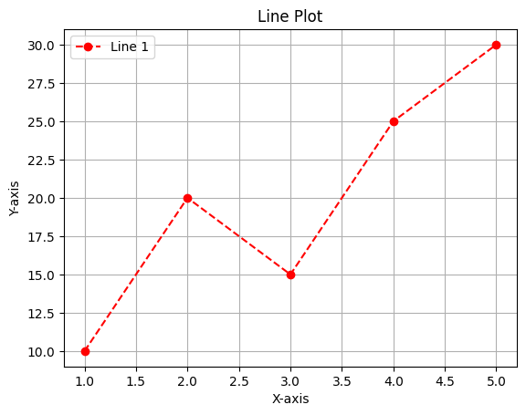
Line Plot (Visualizes trends over time or sequences.)
import matplotlib.pyplot as plt # Sample Data
x = [1, 2, 3, 4, 5]
y = [10, 20, 15, 25, 30]
# Create Line Plot
plt.plot(x, y, marker='o', linestyle=‘--', color=‘r', label='Line 1')
plt.title("Line Plot")
plt.xlabel("X-axis") plt.ylabel("Y-axis") plt.legend() plt.grid() plt.show()

Slide 7
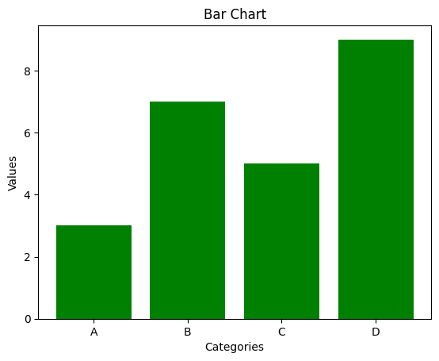
Bar Chart
Compares categorical data. categories = ['A', 'B', 'C', 'D'] values = [3, 7, 5, 9]
plt.bar(categories, values, color='green') plt.title("Bar Chart")
plt.xlabel("Categories") plt.ylabel("Values")
plt.show()

Slide 8
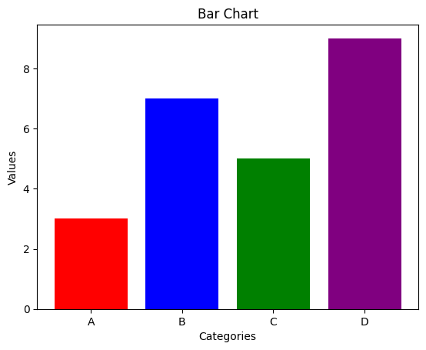
Bar Chart (Compares categorical data.)
# Sample Data
categories = ['A', 'B', 'C', 'D'] values = [3, 7, 5, 9]
# Create Bar Chart
plt.bar(categories, values, color=['red', 'blue', 'green', 'purple'])
plt.title("Bar Chart") plt.xlabel("Categories") plt.ylabel("Values") plt.show()

Slide 9
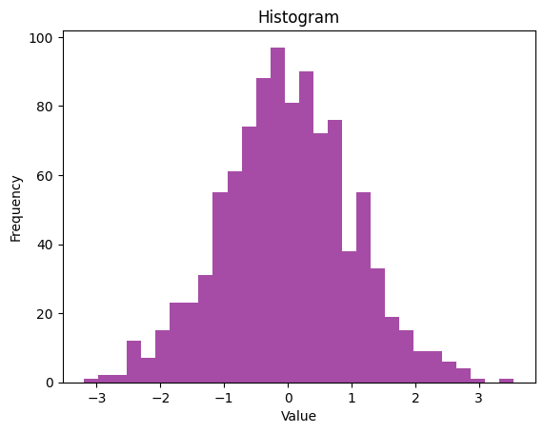
Histogram
Displays the distribution of a dataset.
import numpy as np
data = np.random.randn(1000)
plt.hist(data, bins=30, color='purple', alpha=0.7) plt.title("Histogram")
plt.xlabel("Value") plt.ylabel("Frequency")
plt.show()

Slide 10
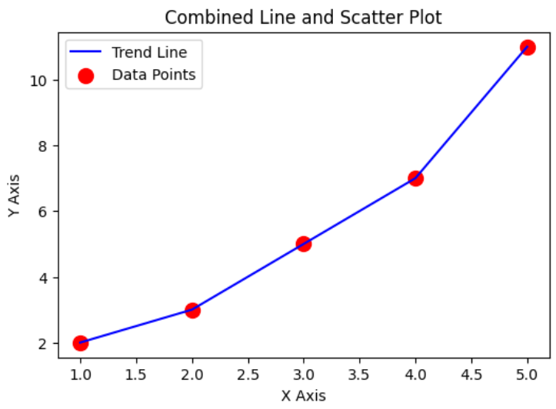
Preparing Canvas
x = [1, 2, 3, 4, 5]
y = [2, 3, 5, 7, 11]
1. Create a single canvas and axis
fig, ax = plt.subplots(figsize=(6, 4))
2. Layer multiple plots sequentially on the same axis (ax)
ax.plot(x, y, color='blue', label='Trend Line')
ax.scatter(x, y, color='red’,
s=100, label='Data Points')
ax.set_title("Combined Line and Scatter Plot")
ax.set_xlabel("X Axis")
ax.set_ylabel("Y Axis")
ax.legend()
plt.show()

Slide 11
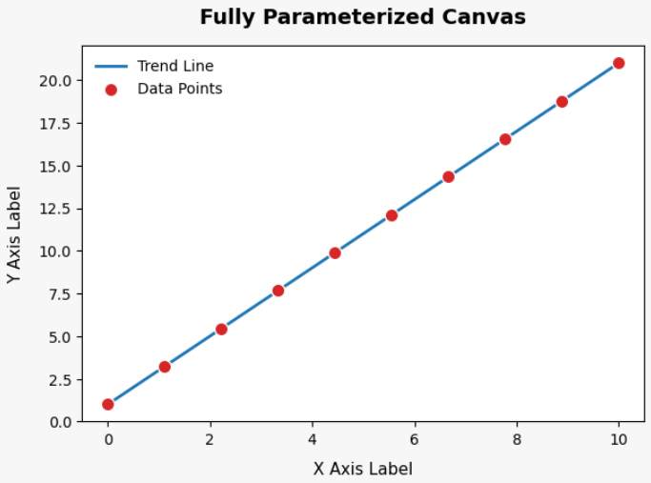
3. Layer the Plots on the Same Axis
ax.plot(x, y, color='#1f77b4', linewidth=2, zorder=1, label='Trend Line’)
ax.scatter(x, y, color='#d62728', s=80, edgecolor='white', zorder=2, label='Data Points')

Slide 12
4. Canvas Padding & Margin Control
fig.subplots_adjust(
left=0.15, # Margin on the left side
right=0.90, # Margin on the right side bottom=0.15, # Margin on the bottom
top=0.85, # Margin on the top
wspace=None, # Width padding between subplots
hspace=None # Height padding between subplots
)

Slide 13
5. Axis Padding & Styling
ax.set_facecolor('white') # Background color of the plotting area
ax.set_title("Fully Parameterized Canvas", fontsize=14, pad=15, weight='bold’)
ax.set_xlabel("X Axis Label", fontsize=11, labelpad=10)
ax.set_ylabel("Y Axis Label", fontsize=11, labelpad=10)
ax.legend(loc='upper left', frameon=True, facecolor='white', edgecolor='none')

Slide 14
canvas
import matplotlib.pyplot as plt
import numpy as np
1. Sample Data
x = np.linspace(0, 10, 10)
y = 2 * x + 1

Slide 15
2. Fully Parameterized Canvas Creation
fig, ax = plt.subplots(
nrows=1, # Single row
ncols=1, # Single column
figsize=(7, 5), # Canvas width & height in inches
dpi=100, # Resolution (dots per inch)
facecolor='#f7f7f7’, # Background color
edgecolor='none’, # Border color around the canvas
linewidth=0, # Thickness of the canvas border
subplot_kw=None, # Dictionary of projection
)

Slide 16
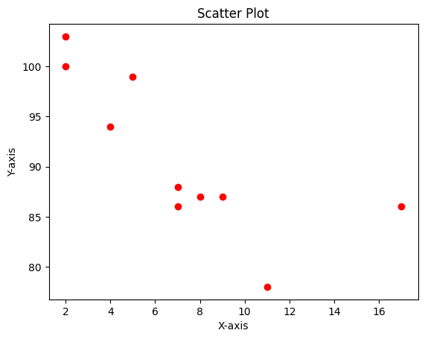
Scatter Plot
Displays relationships between two variables.
x = [5, 7, 8, 7, 2, 17, 2, 9, 4, 11]
y = [99, 86, 87, 88, 100, 86, 103, 87, 94, 78]
plt.scatter(x, y, color='red') plt.title("Scatter Plot") plt.xlabel("X-axis") plt.ylabel("Y-axis") plt.show()

Slide 17
Customizing Plots
Adding Titles and Labels plt.title("Title Here") plt.xlabel("X-axis Label") plt.ylabel("Y-axis Label")
Adding Legends
plt.plot(x, y, label="Line 1") plt.legend()
Adding Grids
plt.grid()

Slide 18
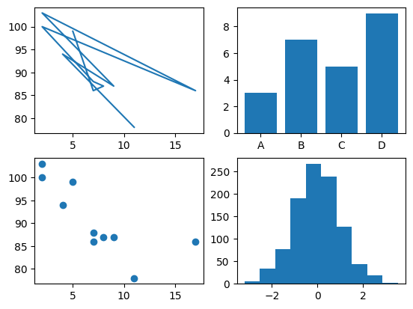
Advanced Features
Subplots
Multiple plots in one figure. fig, axs = plt.subplots(2, 2) axs[0, 0].plot(x, y)
axs[0, 1].bar(categories, values) axs[1, 0].scatter(x, y)
axs[1, 1].hist(data) plt.show()

Slide 19
Advanced Formatting & Exporting
When preparing charts for professional reports, the default sizing often isn't enough.
figsize=(8, 5) creates a wider canvas. We use hex color codes (#2ca02c) for precise branding. Most importantly,
plt.xlim() and plt.ylim() lock the axes. This prevents Matplotlib from auto-scaling the axes, which is crucial if you are comparing multiple graphs side-by-side and need their scales to be identical.
plt.figure(figsize=(8, 5))
epochs = [1, 2, 3, 4, 5]
accuracy = [0.65, 0.72, 0.80, 0.85, 0.89]
plt.plot(epochs, accuracy, marker='s', color='#2ca02c') plt.title("Model Accuracy over Epochs")
plt.xlabel("Epoch")
plt.ylabel("Accuracy")
plt.xlim(0, 6)
plt.ylim(0.5, 1.0)
plt.show()

Slide 20
Pie Charts
Pie charts are perfect for illustrating part-to-whole relationships, like how we split datasets in machine learning.
The explode parameter is a great tool for emphasis, it 'explodes' a specific slice out from the center so the audience focuses on it.
The autopct parameter automatically calculates and formats our raw numbers into readable percentages on the chart itself.
labels = ['Training Data', 'Validation Data', 'Test Data']
sizes = [70, 15, 15]
colors = ['#ff9999','#66b3ff','#99ff99']
explode = (0.1, 0, 0)
plt.pie(sizes, explode=explode, labels=labels, colors=colors, autopct='%1.1f%%', shadow=True, startangle=140)
plt.title("Standard Dataset Split")
plt.show()

Slide 21
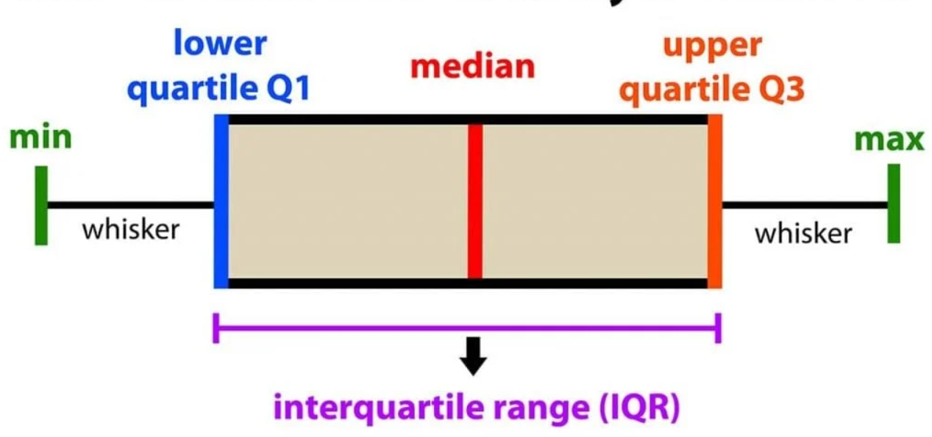
Box Plots for Distribution
Averages don't tell the whole story. Box plots show us the distribution of our data. The orange line in the middle is the median. The box contains the middle 50% of your data, and
the whiskers show the range. Those little circles at the top and bottom? Matplotlib automatically detects and plots statistical outliers for you.
This is essential when evaluating if a model is consistently good or just got lucky on a few runs.
np.random.seed(42)
model_a_scores = np.random.normal(85, 5, 100)
model_b_scores = np.random.normal(88, 3, 100)
plt.figure(figsize=(10, 3))
plt.boxplot([model_a_scores, model_b_scores], labels=['Model A', 'Model B'])
plt.title("Performance Variance Across Runs")
plt.ylabel("F1 Score")
plt.show()

Slide 22
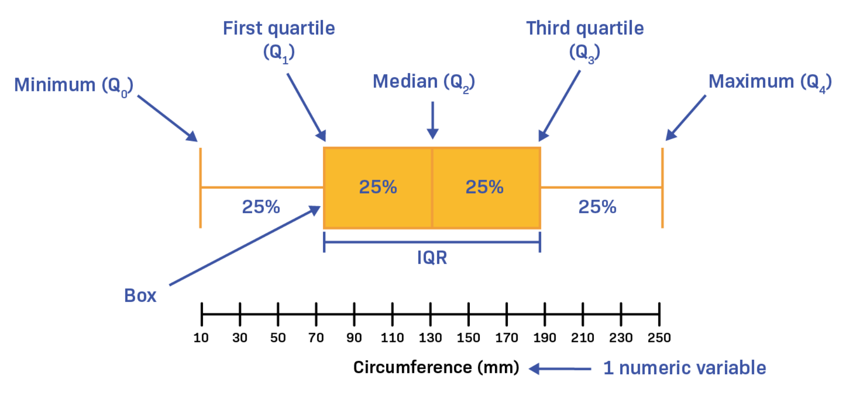
Outlier Detection
The IQR represents the range of the middle 50% of the data.
Formula:
IQR = Q3 - Q1
Q3 = Third Quartile (75th percentile) (0.75)
Q1 = First Quartile (25th percentile) (0.25)

Slide 23
Outlier Detection
Lower bound: Q1 - (1.5*IQR)
Upper bound: Q3 + (1.5* IQR)
def remove_outliers_iqr(df, column):
Q1 = df[column].quantile(0.25)
Q3 = df[column].quantile(0.75)
IQR = Q3 - Q1
lower_bound = Q1 - 1.5 * IQR
upper_bound = Q3 + 1.5 * IQR
return df[(df[column] >= lower_bound) & (df[column] <= upper_bound)]

Slide 24
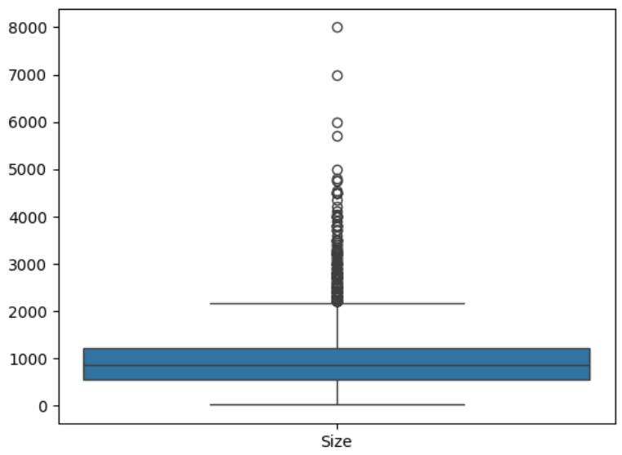
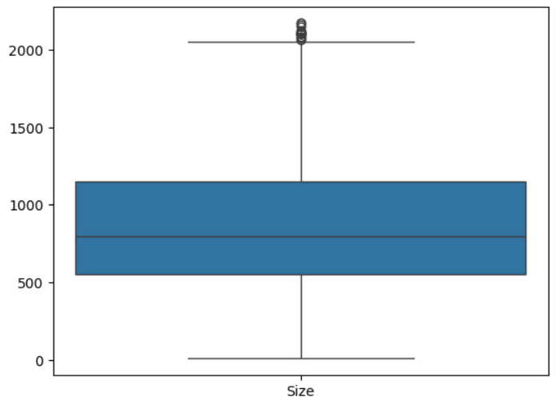
Initial Dataset
Dataset after outlier removal

Slide 25
The Anatomy of a Box Plot
Minimum (min): The lowest data point in your dataset, excluding any statistical outliers. It marks the end of the left whisker.
Lower Quartile (Q1): The 25th percentile. Exactly 25% of your data points fall below this line. It forms the left edge of the box.
Median (Q2): The 50th percentile, or the exact middle value of your dataset. Half the data is above this red line, and half is below. It shows the central tendency of your data.
Upper Quartile (Q3): The 75th percentile. Exactly 75% of your data falls below this line (meaning 25% is above it). It forms the right edge of the box.
Maximum (max): The highest data point in your dataset, excluding outliers. It marks the end of the right whisker.
Interquartile Range (IQR): The physical length of the box, calculated as $IQR = Q3 - Q1$. This is the most crucial part of the plot because it represents the "middle 50%" of your data. It shows where the bulk of your typical values lie.
Whiskers: The lines extending outward from the box to the min and max. They show the full spread of the data outside the middle 50%.

Slide 26
import numpy as np
data = [12, 15, 17, 20, 22, 25, 29, 35, 40, 65]
2. Calculate the Quartiles and Median using percentiles
q1 = np.percentile(data, 25)
median = np.median(data) # Equivalent to np.percentile(data, 50)
q3 = np.percentile(data, 75)
3. Calculate the Interquartile Range (IQR)
iqr = q3 - q1
4. Determine the whisker bounds (standard 1.5 * IQR rule)
lower_bound = q1 - (1.5 * iqr)
upper_bound = q3 + (1.5 * iqr)
5. Find actual Min and Max within the bounds (excluding outliers)
We filter the data to only include points within our calculated bounds
min_val = np.min([x for x in data if x >= lower_bound])
max_val = np.max([x for x in data if x <= upper_bound])

Slide 27
# 6. Display the results
print("--- Box Plot Statistics ---")
print(f"Minimum: {min_val}")
print(f"Q1: {q1}")
print(f"Median: {median}")
print(f"Q3: {q3}")
print(f"Maximum: {max_val}")
print(f"IQR: {iqr}")
# Identify any outliers
outliers = [x for x in data if x < lower_bound or x > upper_bound]
if outliers:
print(f"Outliers detected: {outliers}")

Slide 28
Pandas + NumPy + Matplotlib
import pandas as pd
import numpy as np
import matplotlib.pyplot as plt
1. PANDAS: Load a real dataset directly from the internet
url = "https://raw.githubusercontent.com/mwaskom/seaborn-data/master/titanic.csv"
df = pd.read_csv(url)
2. PANDAS: Clean and Group the data
# Let's find the average ticket fare for each passenger class
fare_by_class = df.groupby('class')['fare']
avg_fares = fare_by_class.mean()

Slide 29
3. NUMPY: Mathematical operations
Calculate the standard deviation to see the price variance in each class
std_fares = fare_by_class.apply(np.std)
# Generate evenly spaced positions for our X-axis bars
x_positions = np.arange(len(avg_fares))
4. MATPLOTLIB: The Visualization
plt.figure(figsize=(9, 6))
plt.bar(x_positions, avg_fares, yerr=std_fares, capsize=7,
color=['#gold', '#silver', '#cd7f32'], alpha=0.8, edgecolor='black')
plt.show()

Slide 30
Replace the numeric x-positions with the actual class names from Pandas
plt.xticks(x_positions, avg_fares.index, fontsize=12)
# Formatting the plot
plt.title("Titanic Passenger Fares by Class\n(with Standard Deviation)", fontsize=14)
plt.ylabel("Ticket Fare (£)", fontsize=12)
plt.xlabel("Passenger Class", fontsize=12)
plt.grid(axis='y', linestyle='--', alpha=0.7)
plt.tight_layout()

Slide 31
Saving Plots
plt.savefig("plot.png")
# Save the plot as a PDF plt.savefig('plot.pdf')
When to Use Matplotlib?
When creating simple and static visualizations.
When you need detailed customization.
Ideal for data exploration and reporting.
Limitations
Not as aesthetically modern as Seaborn or Plotly.
Requires more effort for advanced visualizations.

Slide 32
Best Practices & Conclusion
Label axes and add titles for clarity.
Use legends for multiple datasets.
Choose appropriate plot types for your data.
Maintain consistent styles for readability.
Conclusion
Matplotlib is a powerful and versatile library for visualizing data.
Its wide range of features and customization options make it a go- to tool for data scientists and analysts.
Explore more at: Matplotlib Documentation

Slide 33
Introduction to Seaborn
What is Seaborn?
Seaborn is a Python data visualization library built on top of Matplotlib.
Provides a high-level interface for drawing attractive and informative statistical graphics.
Works seamlessly with Pandas DataFrames and NumPy arrays.

Slide 34
Key Features
Easy creation of complex visualizations with minimal code.
Built-in themes for better aesthetics.
Statistical visualization capabilities (e.g., histograms, KDE plots).
Integration with Pandas for handling data.
Support for multi-plot grids.
Installing Seaborn
pip install seaborn

Slide 35
Basic Workflow
Import the library: import seaborn as sns.
Load or prepare your dataset (e.g., Pandas DataFrame).
Use Seaborn functions like sns.barplot() or sns.heatmap() to create plots.
Customize the plots using arguments, themes, and Matplotlib tools.
Display the plot using plt.show().

Slide 36
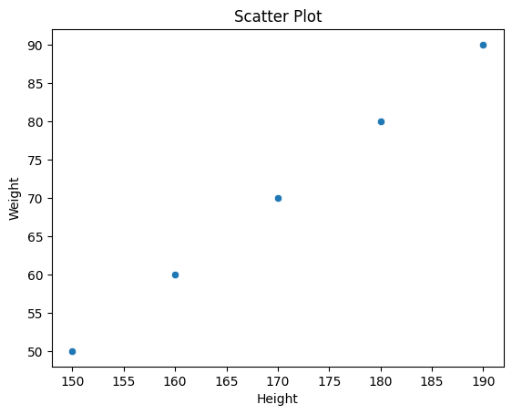
Common Plot Types
Scatter Plot
Visualizes relationships between two variables.
import seaborn as sns
import matplotlib.pyplot as plt
# Sample Data data = {
'Height': [150, 160, 170, 180, 190],
'Weight': [50, 60, 70, 80, 90]
}
sns.scatterplot(x='Height', y='Weight', data=data) plt.title("Scatter Plot")
plt.show()

Slide 37
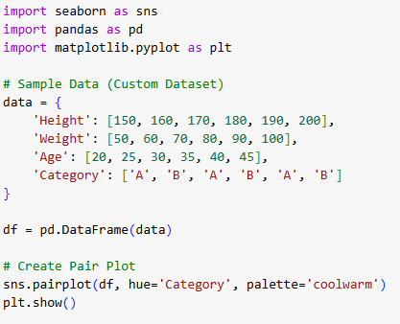
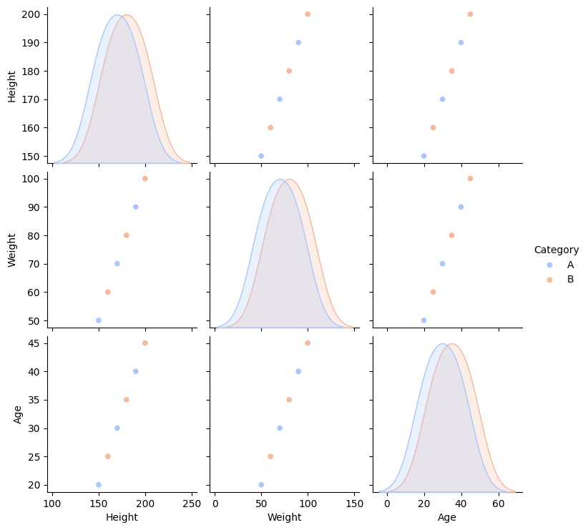
2. Pair Plot
Pair Plot: Use for relationships between multiple variables. Creates pairwise scatter plots for all numeric columns in a dataset. Example: Height, Weight, and Age with a categorical column.

Slide 38
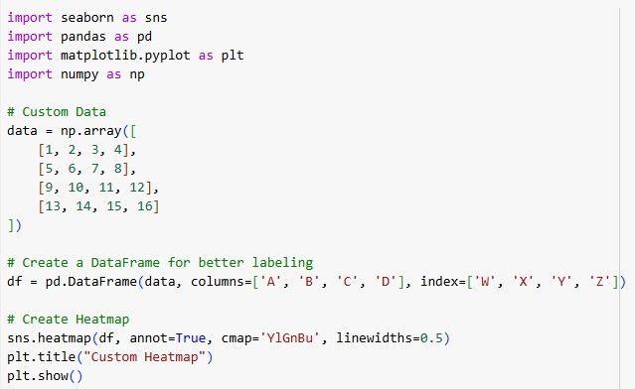
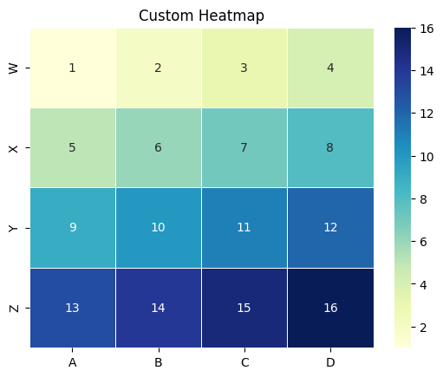
3. Heatmap
Visualize matrix-like data.
Example: Tabular data with rows and columns.

Slide 39
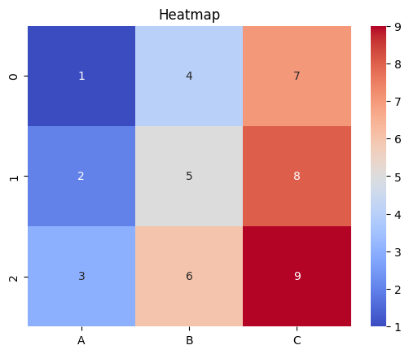
Heatmap example 2
import seaborn as sns
import pandas as pd # Sample Data
data = pd.DataFrame({
'A': [1, 2, 3],
'B': [4, 5, 6],
'C': [7, 8, 9]
})
sns.heatmap(data, annot=True, cmap='coolwarm’)
plt.title("Heatmap") plt.show()

Slide 40
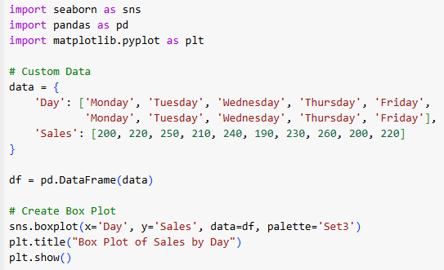
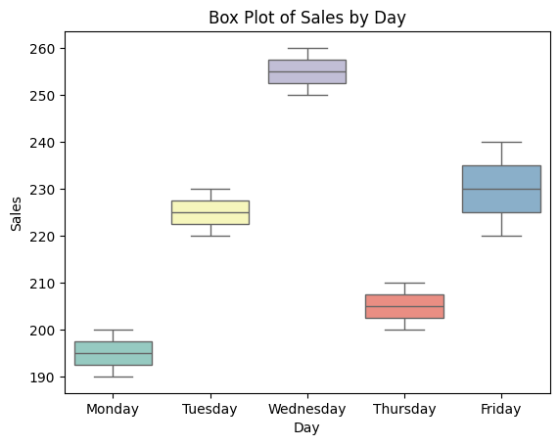
4. Box Plot
Analyze distributions and detect outliers. Example: Sales data over different days.

Slide 41
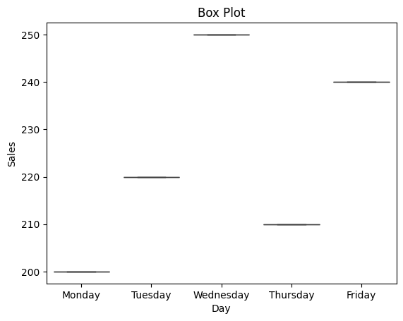
Box Plot Example 2
import seaborn as sns
# Sample Data
data = {
'Day': ['Monday', 'Tuesday',
'Wednesday', 'Thursday', 'Friday'],
'Sales': [200, 220, 250, 210, 240]
}
sns.boxplot(x='Day', y='Sales', data=data) plt.title("Box Plot")
plt.show()

Slide 42
Customizing Seaborn Plots
Themes
Available themes: darkgrid, whitegrid, dark, white, ticks.
sns.set_theme(style="whitegrid")
Adding Titles and Labels
plt.title("Title Here")
plt.xlabel("X-axis Label")
plt.ylabel("Y-axis Label")
Adjusting Color Palettes
sns.set_palette("pastel")

Slide 43
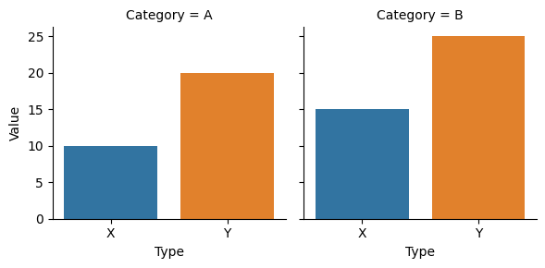
Advanced Features
FacetGrid
Allows creation of multiple plots based on subsets of data.
import seaborn as sns import pandas as pd
# Sample Data
data = pd.DataFrame({
'Category': ['A', 'A', 'B', 'B'], 'Value': [10, 20, 15, 25],
'Type': ['X', 'Y', 'X', 'Y']
})
facet = sns.FacetGrid(data, col="Category", hue="Type")
facet.map(sns.barplot, "Type", "Value")
plt.show()

Slide 44
When to Use Seaborn?
When creating aesthetically pleasing visualizations quickly.
When visualizing statistical data with complex relationships.
For integrating with Pandas for data analysis workflows

Slide 45
Limitations & Best Practices
Limitations
Not as flexible as Matplotlib for very customized plots.
Requires Matplotlib for certain advanced features.
Best Practices
Use themes to maintain consistency.
Choose the right plot type for your data.
Combine Seaborn with Matplotlib for advanced customization.

Slide 46
Conclusion
Seaborn simplifies statistical data visualization in Python.
Its ease of use and integration with Pandas make it ideal for data scientists.
Explore more at: Seaborn Documentation

Slide 47
Thank You! ☺

